Slide 1

Team Name: 7/11: Hassan Emam, Mohamed Abdelaal, Rory French, Roberta Descrovi, Tom Wren, Clare Preston and Zheng Challenge 9

Slide 2
Problem
Multiple projects data feeding into one excel reporting page informing the projects status.
The data were fragmented and manually extracted and combined into a summary sheet.
This way of reporting will lead to extra time for gathering and extracting the data, in addition the quality of data is not checked which will result in bad decision. That will cause a time and cost overruns to the organisation in return.

Slide 3

Solution
As the data was on excel and not structured. We have started storing the data on the cloud using ETL and SQL database (using SSIS and Python)
The brief was to use a PowerApp linked to Cloud hosted SQL DB database
Power BI Dashboard was created to aggregate data and produce useful actionable information

Slide 4
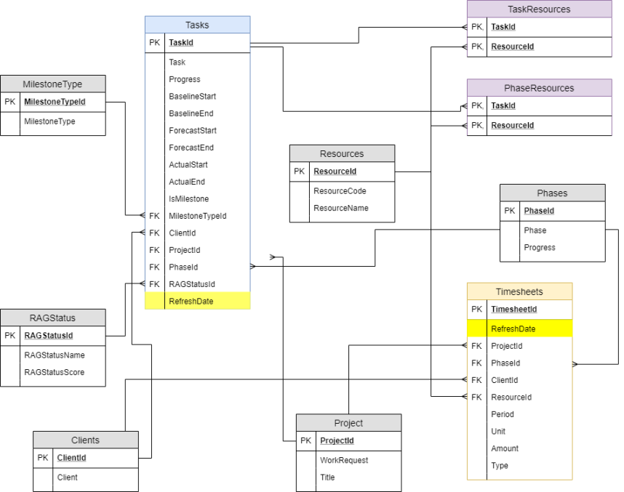

Slide 5
User stories
User Journey: Management
As a user, I want to be able to see the current RAG status of each project
As a user, to predict future outcomes and forecast more effectively
determining how long each type of project should take and the resource, time & cost commitments that should be allocated to them
As a user, I want to use Power App/BI tech to draw conclusions from the data – analyse plan dates v actuals, analyse by Phase and related resource,
As a user, I want to see the main blocker for tasks being delivered on time
As a user, I want to get early notice of tasks which are due to exceed agreed deliverable timescales (totalfloat)
User Journey: Project member
As a user, I want to be able to quickly update my current tasks with amended actual dates
As a user, I want to be able to identify delays from a pre-defined list
As a user, I want to be able to add progres % and end date so that management can act on remaining scope moving forwards
As a user, I want to see my current and lookahead tasks
As a user, I want to be alerted when outstanding tasks are due to breach acceptable limits (TotalFloat)

Slide 6


Slide 7


Slide 8

Questions from Judges
The end user is using data factory to process this transformation, what maintenance is associated with this?
What if Computershare make an adjustment to the highlight report?
What costs would Computershare be exposed to using Azure?
Would Computershare get a good enough ROI using Azure for this?

Slide 9

Benefits
Quick, automated project tracking
Time-saving
No data duplication
No paperwork
One source of data
Accessible by all, with different user access rights
Actionable insights into RAGS using PowerBI / App
Live view of weekly progress status
Feedback loop between project team and management

Slide 10
Future Development
Analysis of tasks started early – is there a pattern? Could that be used to build in a cushion on task plan date?
Using resource availability to auto assign task owner based on available resource, skillset etc
Adding a comment bar to identify blockers that need to be mitigated in the future to avoid potential delays
Push notifications – i.e. if the team member knows a task is going to be late, they can provide early notification to related resource and management
· Work days v non work days calendar + holidays for the resources

Slide 11
Presentation | Pitch and sticking to time (5 mins)
Solution | Did you solve the challenge?
Technology | How innovative is it?
Commercial Application | Can we pick it up and do something with it?
Benefit | How is this going to help us? E.g. Improve sustainability, project delivery, reduce cost, safety incidents, employee wellbeing

